Slide 2
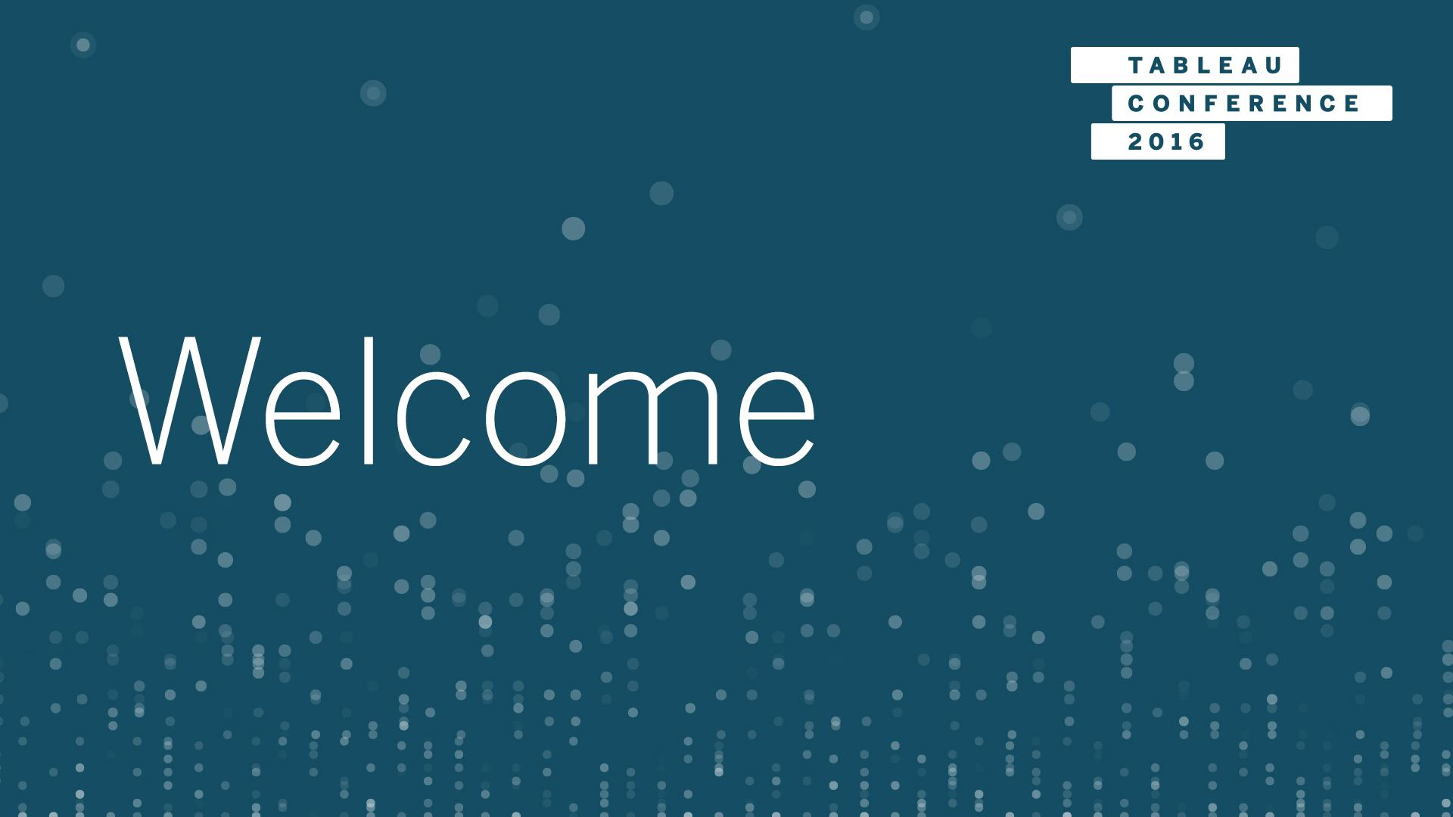
Welcome
Notes:
Rachel

Slide 3

Tableau + Python =
#Data17
Rachel Bowes | Product Consultant
Mohamed El Jaafari | Product Consultant
Notes:
Rachel
before / after data night out

Slide 4

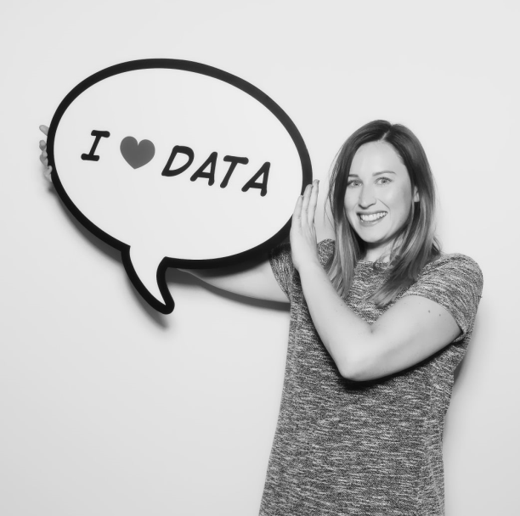


TEAM CALC!
#Data17
Mo | Product Consultant
meljaafari@tableau.com
@Med_EJ
Rachel | Product Consultant
rbowes@tableau.com
@RachelBowes90
Notes:
Hi Everybody
Mo - 2 Years Tableau - background in stats - calculation wizard - Team Calc - part of our club external services - morocco - 50 countries before 50.
Rachel - my fellow team calc member - too modest
Spatial analysis - team calc turned into a more general study club (still just 2 members)
And we explored using tableau's integrations with Python to take our analysis to the next level -
Used python for Regression Testing - Not as FUN as Tableau
From North England - way beyond the wall - she sounds like ygritte, right?
Both Product consultants - based in London……

Slide 5

#Data17
Notes:
……. - Europe / Middle east & Africa - help customers be successful on their Tableau Journey.
(Rachel) Introduce Assistants
What level people are: python not Tableau? Tableau not Python? Both?
(mo) - level of the session - not going to teach you how to write python
(Rachel) - 10- 15 mins talk about whey we're running the session, what we'll cover and basic background knowledge you'll need when we get to the hands on section.

Slide 6
The Why?
Notes:
Rachel
Sometimes we need to go out of what tableau can do out of the box for this session how TabPy can help you with that.

Slide 7
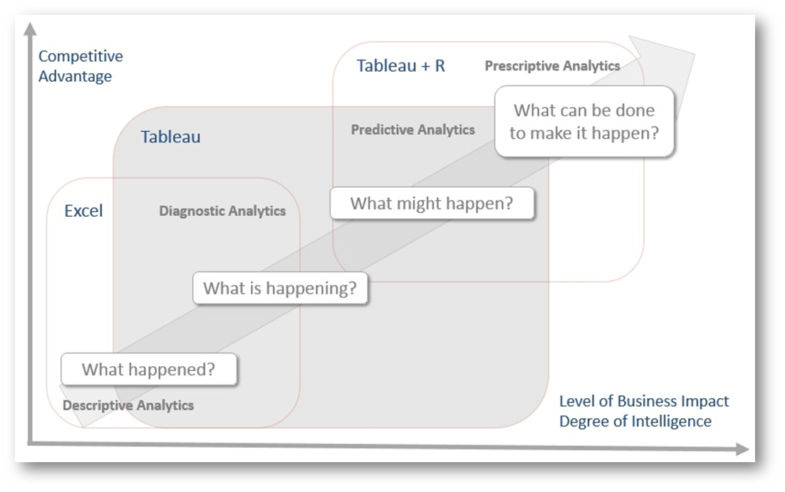
Advanced Analytics
Notes:
Rachel
Advanced analytics – buzz word
future outcomes - sophisticated statistical models - machine learning - neural networks - text analytics, and other advanced data mining techniques.
Am I going to drive benefit for my business if I implement some sort of advanced analytics?
customer consulting - lot of customers - industries and more and more common that people want to take their analysis to the next stage.

Slide 8
Advanced Analytics
Notes:
Rachel
movin on from the excel days of learning what happened / what’s happening,

Slide 9
Advanced Analytics
Notes:
Rachel
on to looking at what might happen. Tableau as a stand alone product is really good at all of

Slide 10
Advanced Analytics
Notes:
Rachel
but sometimes we need to use add an extra tool to our tool belt to look at more prescriptive analytics and trying to identify what can be done to make something happen.
Goad of todays session - we see people are excited, many people struggle, we want to show you what we consider the easiest way to work with python in Tableau and we want to show you some examples to inspire you.

Slide 11
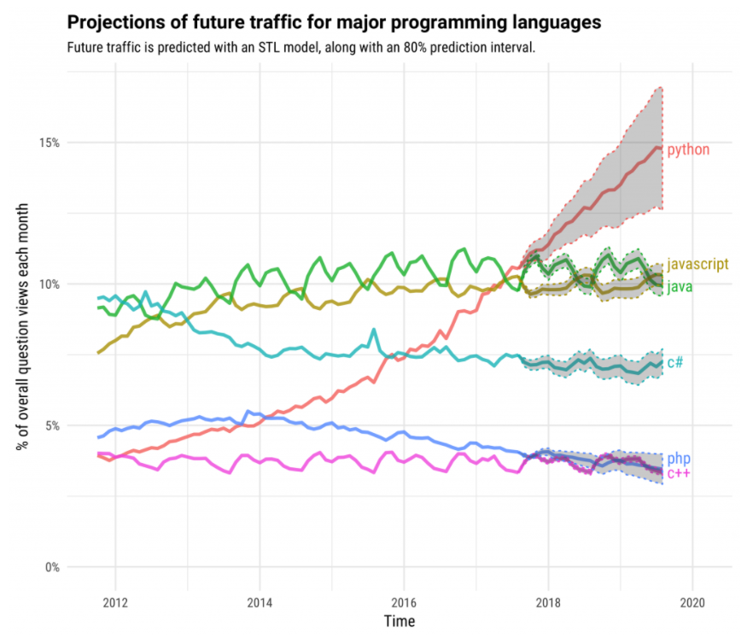
Why Python?
Notes:
stack overflow - high-income countries
We have connections to other external services to perform advanced analytics (R / Matlab) but i’m personally am most interested in Python is it growth and expansion in the industry,
I personally have made it s key part of my personal development to ramp up in this area
more non-coders picking up Python as its an easy language to learn. becoming more mainstream.

Slide 12


Tableau + Python = TabPy
Statistics and Machine Learning
Productionize Predictive modeling
More expressive power
Data connectivity
Explore at the speed of thought
Interactive Storytelling
Notes:
Rachel
TabPy - Anaconda environment - preinstalled and ready to use with many common Python packages.
Python - Python for Tableau (since 10.2)
Open source
Owned by Tableau – control – updates – improve quality
Bora – github – more details

Slide 13
The What?
Notes:
Mo
What are we going to be doing for the next 2 hours?

Slide 14
Topics
Hands on
Outliers
Clustering
Sentiment Analysis
Regression
Notes:
Mo
All topics come from challenges we commonly see customers run into on a regular basis. We really want to help you address those issues.
Real world use cases & customer examples:
Outliers - more and more data being collected every day, fromIOT infrastructures from sensors, people want to be able to detect aberrations as they happen and take action, Is one turbine overheating, or are micro movements a suspension bridge out of the norm...
Clustering - segment customers to A* customers that they should contact, which customers waste time.
Sentiment Analysis - this is really with the rise of social media, it’s so easy today to gather customer feedback and very useful to quickly spot those negative ones to take actions against
Regression - we all want to be able to predict the future. collect a lot of data but don’t know what affects success (revenue), which of the key variables that we’re collecting have the biggest impact. customers from a specific age group likely to buy our product than others.
Tableau Server / security

Slide 15
The How?
Notes:
Mo

Slide 16
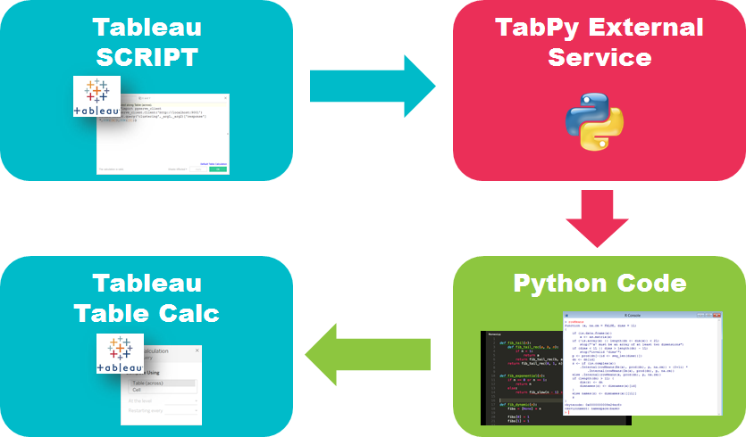
What’s Happening?
Notes:
Mo
Democratizing data science!
The python code is then added to the data model
easy to change, update, and access

Slide 17
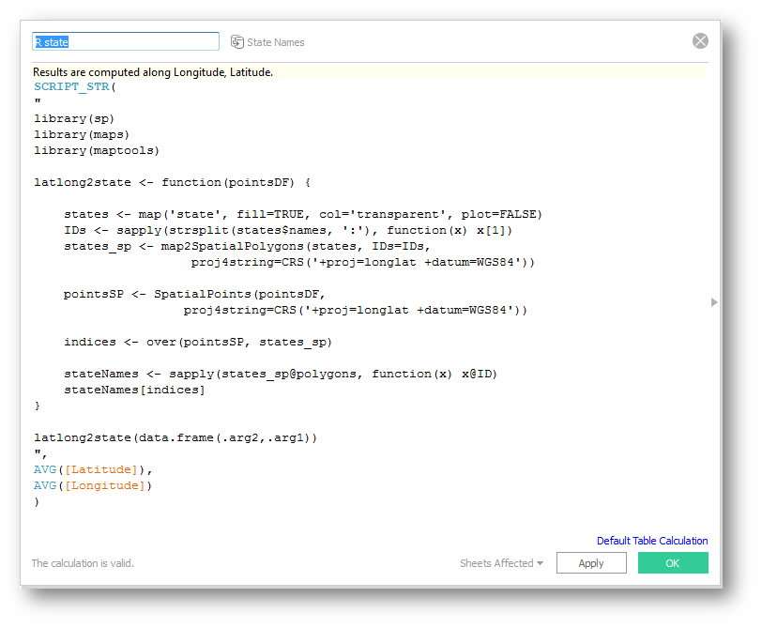
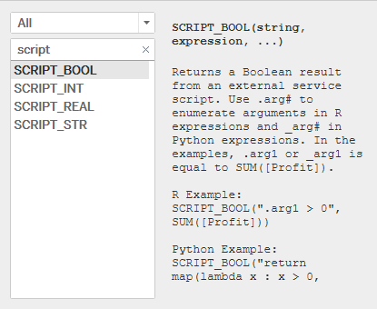
SCRIPT_* Functions
Notes:
Mo
add actions to powerpoint to highlight each bit of the script and explain it.

Slide 18
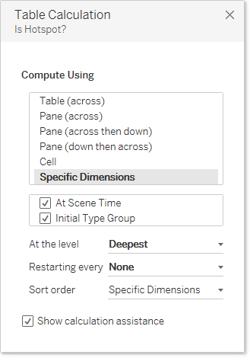
Table Calcs
Notes:
Mo
When using python in tableau, all values are passed and returned via table calculations, this means that the view will affect how values are sent to the TabPy server.
when the partitioning field is very granular this can result in 1000s of server calls which can drastically hinder performance.
for most use cases it makes sense to put ALL fields in the addressing section (check box under specific dimensions) this will result in only a single call to the tabpy server.
When dragging a field out for the first time it may make sense to pause the view, pull in the field, change your compute using option and then hit unpause updates.
There is of course an exception to this if it’s important to brake the view up to answer a specific question like “what are my outleirs within different regions”.
We will look at an example covering both of the situations outlined above.

Slide 19
Time To Get Your Hands Dirty!
Notes:
Rachel

Slide 20


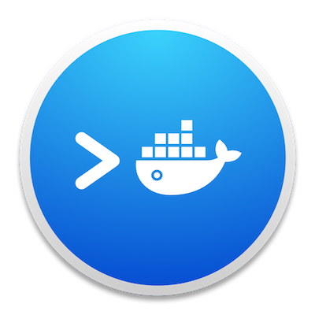

Documents Needed for This Session
Tableau Desktop
Starter Workbook
Guided website
Docker
Notes:
Rachel
housekeeping first
Website works best in chrome.
Talk about Docker and why we’re not using it.

Slide 21

Documents Needed for This Session
Tableau Desktop
Starter Workbook
Guided website
Docker on AWS
Notes:
Rachel
housekeeping first
Website works best in chrome.
Talk about Docker and why we’re not using it.

Slide 22
Structure of the Training
Watch
&
Learn
Key
Concepts
Individual
Exercises
Notes:
Rachel
Go through an example together,
then provide participants with the script needed for the challenge but blank out what script function they need and the arguments they need to pass so they have to think about what is needed.
they will also have to decide what compute using option to use.

Slide 23

You Already Have an Instance of TabPy
Notes:
Rachel

Slide 24
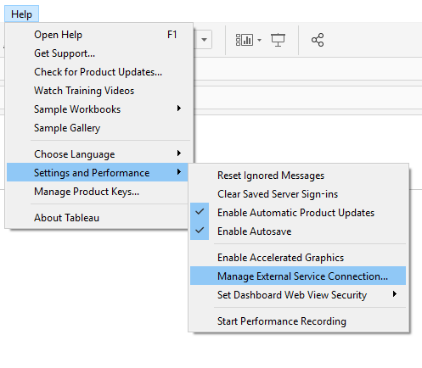
Establish Connection
Notes:
Mo

Slide 25
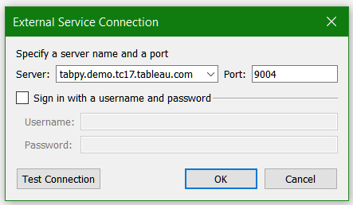
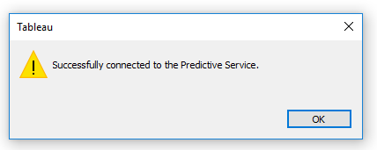
Establish Connection
Notes:
Mo

Slide 26
Outliers
Notes:
outliers -
more and more data being collected every day, integration of sensor outputs and the increase in IOT infrastructure, there is so much data to analyse and people want to be able to detect if a new datapoint fits in with the norm or if something has gone wrong and they need to take action
USE CASE BUSINES CASE: so we’ve had customers from power plants wanting to know is a turbine is overheating, or architects looking at the micro movements of a suspension bridge to monitor if there is too much stress being placed at any given point.
these are the kind of things our first examples today are going to address.

Slide 27
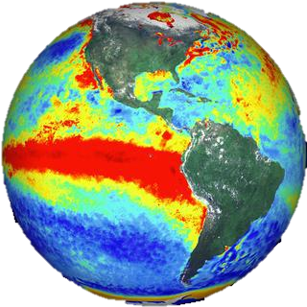
Sea Temperature Outliers
Data:
10 years of historical sea surface temperatures across the Pacific Ocean.
Challenge:
Can you track outliers in the data to see if this matches up with a historic occurrence of El Niño.
Notes:
Rachel
Data - online for use in machine learning challenge to look at occurrences of El Nino and try and predict future occurrences.

Slide 28
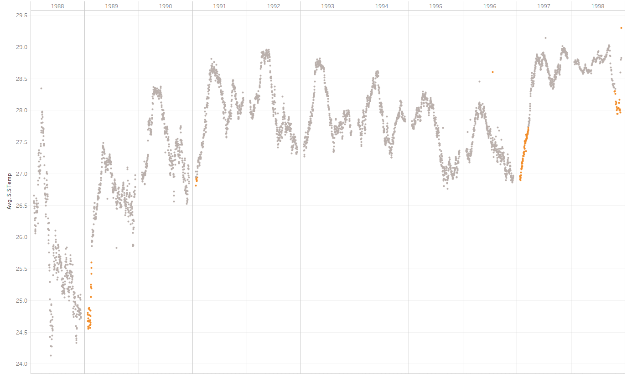
Sea Temperature Outliers
Notes:
Rachel
Scikit Learn - Outlier Detection
walk through example to do together
the goal is to separate a core of regular observations from some polluting ones, called “outliers”. Yet, in the case of outlier detection, we don’t have a clean data set representing the population of regular observations that can be used to train any tool.

Slide 29

Sensor Outliers and IOT
Data:
Temperature output from a gas turbine sensor, recorded on average every minute
Challenge:
The Operations manager of your power plant wants to know when there is irregular fluctuation in the water output.
Notes:
Rachel
The Operations manager of your power plant wants to know when there is irregular fluctuation in the water output.
Turbine sensors record water temperature every minuet.

Slide 30
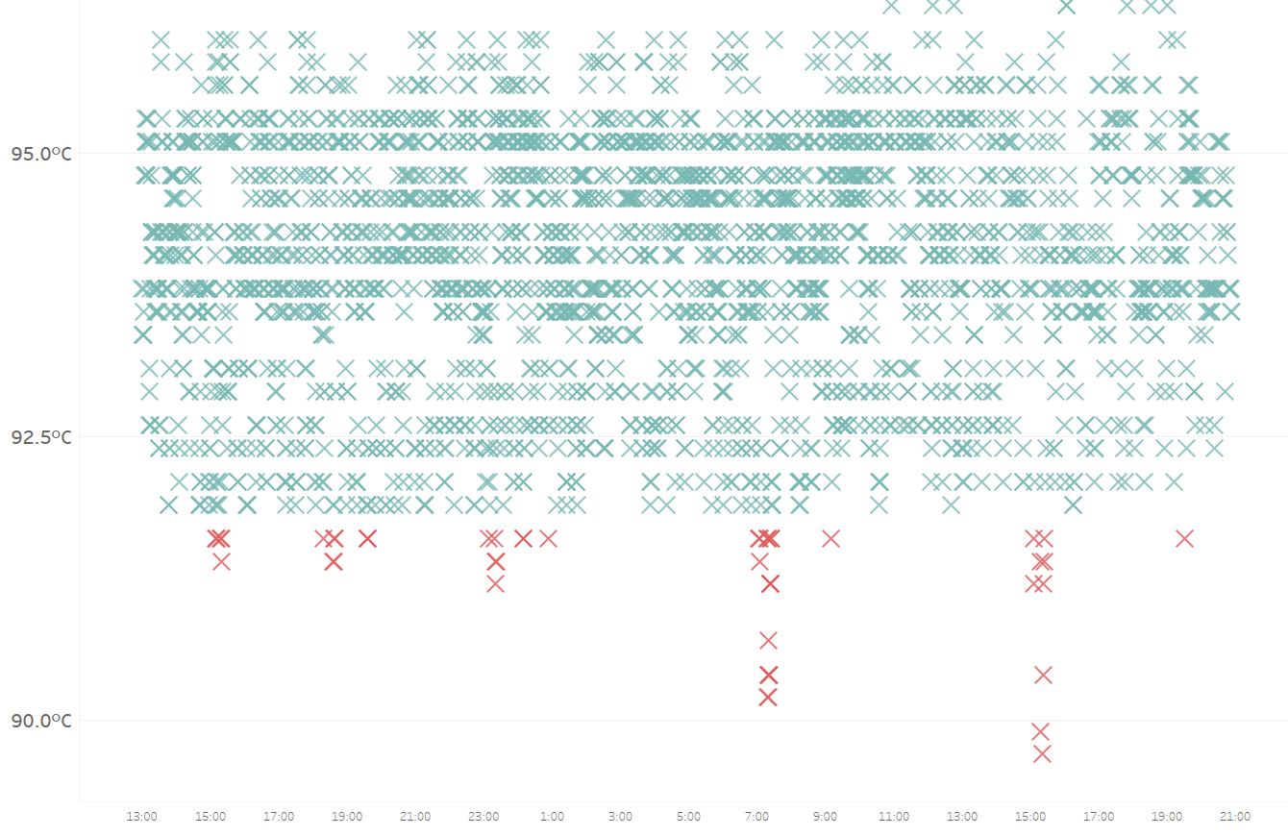
Sensor Outliers and IoT
Notes:
Rachel

Slide 31
Key Takeaways
Outliers
Python can be FUSSY
‘Compute Using’ gives us CONTROL
Spot anomalies & potential issues FAST
Notes:
Running the code:
Python is fussy and indents matter. error message details will help here.
we can control how Python receives the data and therefore how the code is run using the compute using option.
We looked at finding outliers in sea surface temp, and sensor outputs and here we used some simple code but there are more complex outlier detection algorithms and in businesses where time is crucial in detecting and fixing an issue, outlier detection can help you spot issues within masses of data.
Mo’s now going to take over for our second topic - clustering

Slide 32
Clustering
Notes:
Mo
Use case / business case: We are collecting customer data coming from everywhere but we ideally want to group these into segments of customers and be able to easily flag which would be our best customer that we need to engage, and which are our dormant customers we need to reach differently

Slide 33
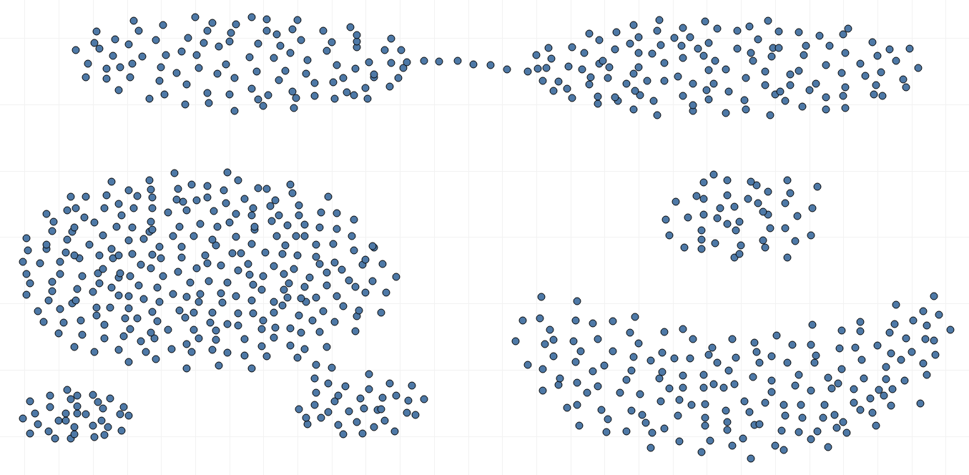
Clustering Points
Data:
X and Y variables
Challenge:
Analyse the difference between k-means and DBSCAN algorithms
Notes:
Mo
The data set that we are looking at reprsents a set of point scattered around based on X & Y variables.
We want to group every set of points together and consider them as a cluster
We can rely on tableau’s K-Mean’s clustering to start, but K-Means clustering builds a set number of centroids (6 here) and group points that are the closest together.. which is not the grouping I would have gone for just looking at the scatterplot.
Other methods of clustering are available, some more sophisticated than other, and some more meant to deal with certain data sets than others
DBSCAN would be the model that would definitely fit better my dataset here, as it looks at the density of points and builds zones (clusters) based on that

Slide 34
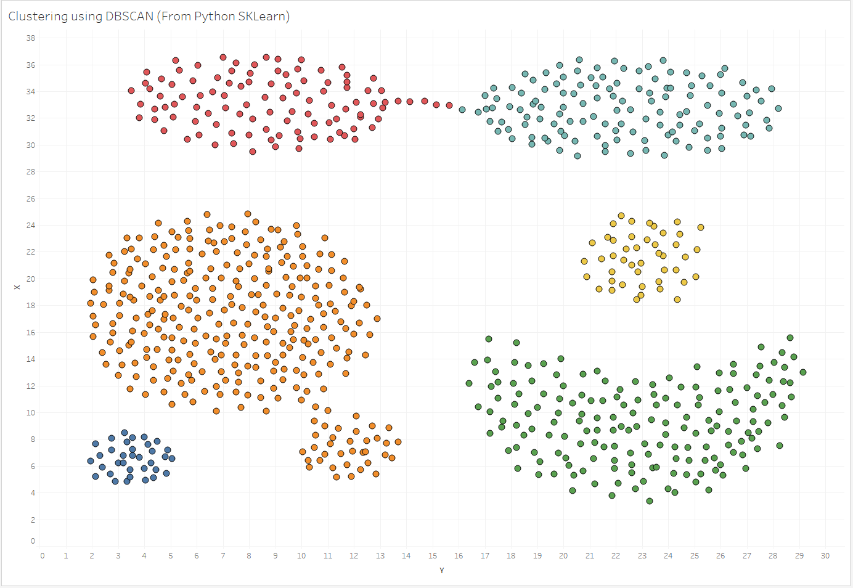
Clustering
Notes:
Mo
DBSCAN
DBSCAN - Density-Based Spatial Clustering of Applications with Noise. Finds core samples of high density and expands clusters from them. Good for data which contains clusters of similar density.

Slide 35

Crimes In Seattle
Data:
Seattle 911 Incidents Report with coordinates of their occurence.
Challenge:
We’re going to our Company event in Seattle, I want to know what areas are safe for me to hang out at
Notes:
Mo
We go to Seattle every year as part of our Global Sales Kick-off and it’s every year the same excitement.
We get to learn about all the new things other teams worldwide work on and get to network with peers located all over the globe
But we get to enjoy seattle as well, and to make the most out of it better hang out late at night in rather safe areas, right?
This dataset looks at 911 calls received around seattle, we’re going to focus on one type of offence and see what are the hot zone that Rachel & I should avoid hanging out.

Slide 36
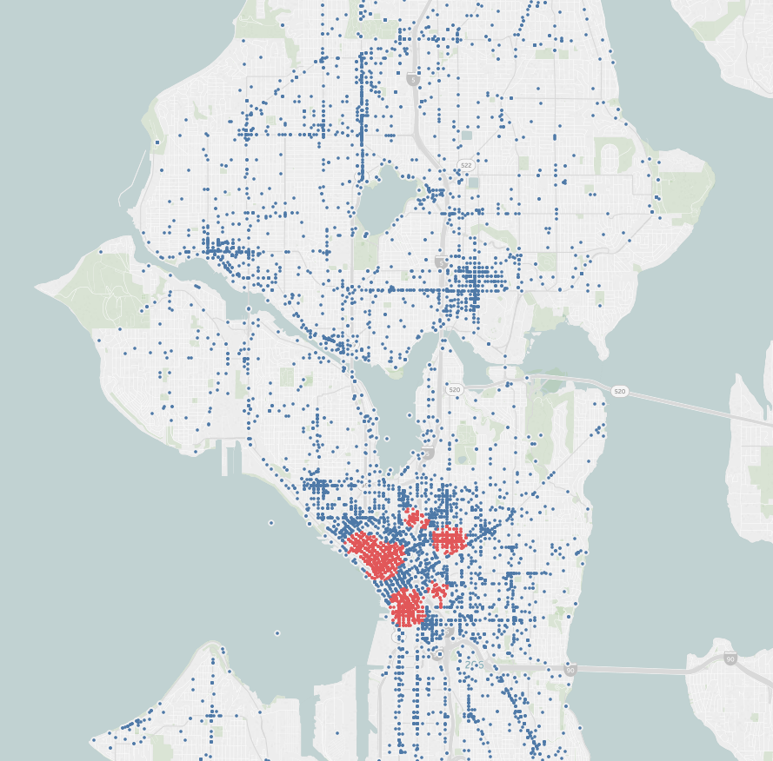
Clustering Crimes in Seattle
Notes:
The haversine formula determines the great-circle distance between two points on a sphere given their longitudes and latitudes

Slide 37
Key Takeaways
Clustering
PARAMETERS are your friend
There is NO ONE SIZE FITS ALL algorithm
Identifies SIMILAR data points
Leads to FURTHER ANALYSIS
Notes:
use paramters to change python code you’re running
more than just one method to model your data
there are more complex clustering models to look at

Slide 38
Sentiment
Notes:
Rachel
Use case for Sentiment:
b2c businesses. Marketing or sellers of consumer goods. Sentiment analysis - twitter data - social media posts.
Instant feedback on how their product or service is being received
Customer example: Newspapers tracking the tags of certain politicians during a campaign to try and predict election outcomes.

Slide 39
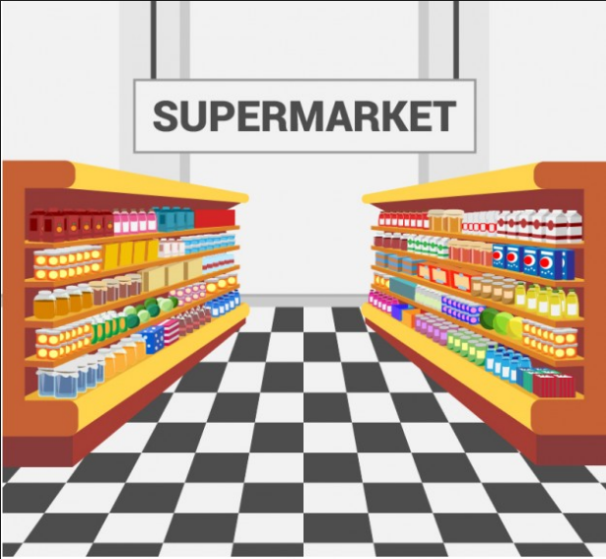
Sentiment Analysis
Data:
Individual comments for every store ID
Challenge:
I gathered comments my customers gave to my 6 stores, can you help me spot negative comments to take action.
Notes:
Rachel

Slide 40
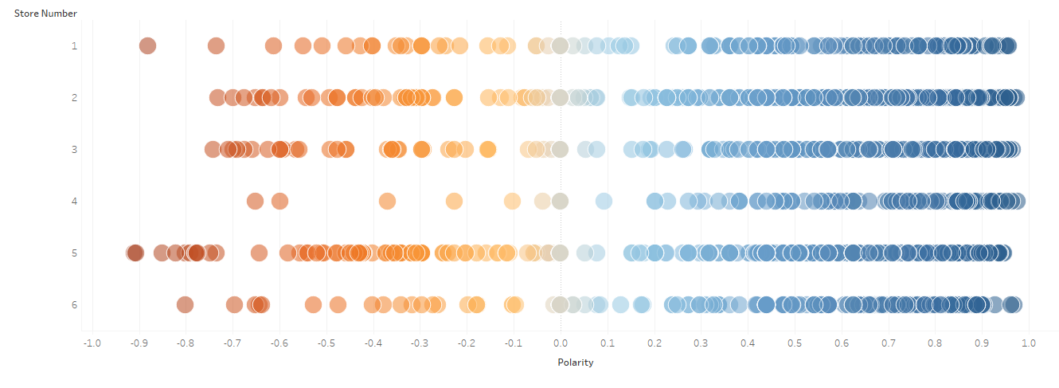
Store Comment Polarity
Notes:
Rachel
Vader
VADER Sentiment Analysis. VADER (Valence Aware Dictionary and sEntiment Reasoner) is a lexicon and rule-based sentiment analysis tool that is specifically attuned to sentiments expressed in social media, and works well on texts from other domains.

Slide 41

Twitter Sentiment Analysis
Data:
Tweets @ cirque de soleil
Challenge:
Is it worth buying tickets to a show this week while I’m in Vegas?

Slide 42
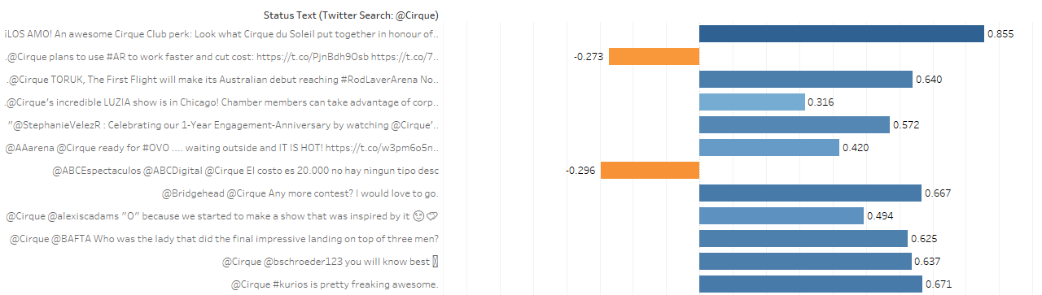
Twitter Sentiment Analysis
Notes:
Rachel

Slide 43
Key Takeaways
Sentiment
Doesn’t understand SARCASM or IRONY
Only as good as the TRAINING MODEL
INSTANT feedback from social media
Action can be taken FAST
Notes:
Sentiment doesn't understand sarcasm or Irony
It’s only as good as the training model it is run against.

Slide 44
Regression
Notes:
Mo
Data that we usually gather contains lots of variables, some are related to each other, some we want to explain and predict missing values of. Regression methods are very useful helping us identifying these relationships among variables.
Use case:
If we want in the medical field how different health conditions can affect someone’s chances of suffering from a certain disease, or what the estimated price of a house based on average income in a neighborhood, size of the house, number of bedrooms, distance to the closest public transport...

Slide 45

Multivariate Linear Regression
Data:
Revenue Vs Average Household Income, Unemployment Rate & Uni Level rate
Challenge:
I need to forecast my projected revenue based on socio-economic factors.
Notes:
Mo
We are tracking in our example here our yearly revenue and want to know how external socio-economic factors affect it and if we can model our future revenue based on estimates of these variables. For this, we are going to rely on a classic linear regression model, which is the basic model that looks for relationship between one variable and explanatory ones.

Slide 46
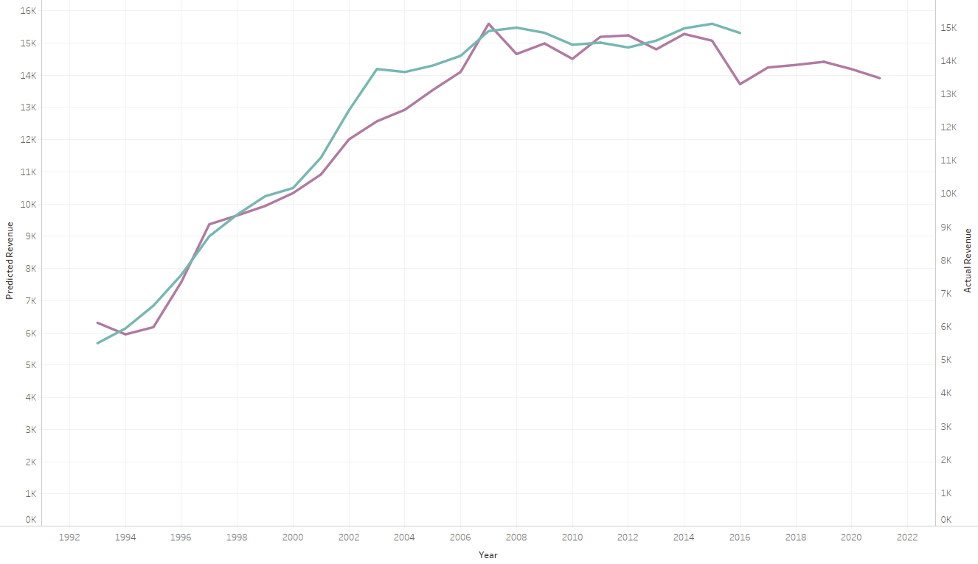
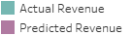
Multivariate Linear Regression
Notes:
Mo
a b c d variables, effect of b, c, d on a.
tableau 2 dimensions. multi - python

Slide 47
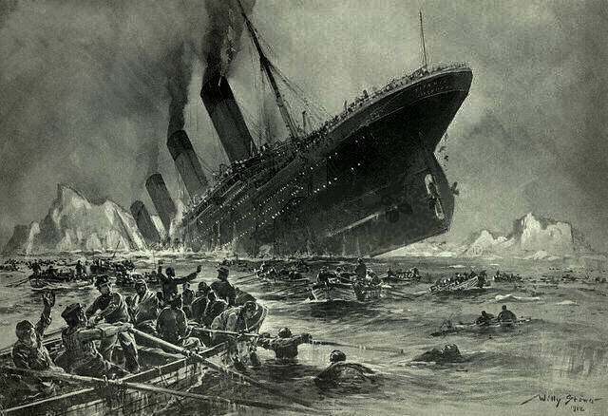
Logistic Regression
Data:
Information about the Titanic survivors
Challenge:
We want to be able to estimate whether a passenger would survive or not based on their age, gender and cabin class.
Notes:
As we are planning on predicting a categorical variable that would take only two value 0 or 1, a logit regression is more applicable.
As you can see on the Titanic Story, there is clearly a trend for people from certain age groups gender and class to survive, but how can we model such a phenomenon and be able to predict the survival of any certain passenger

Slide 48
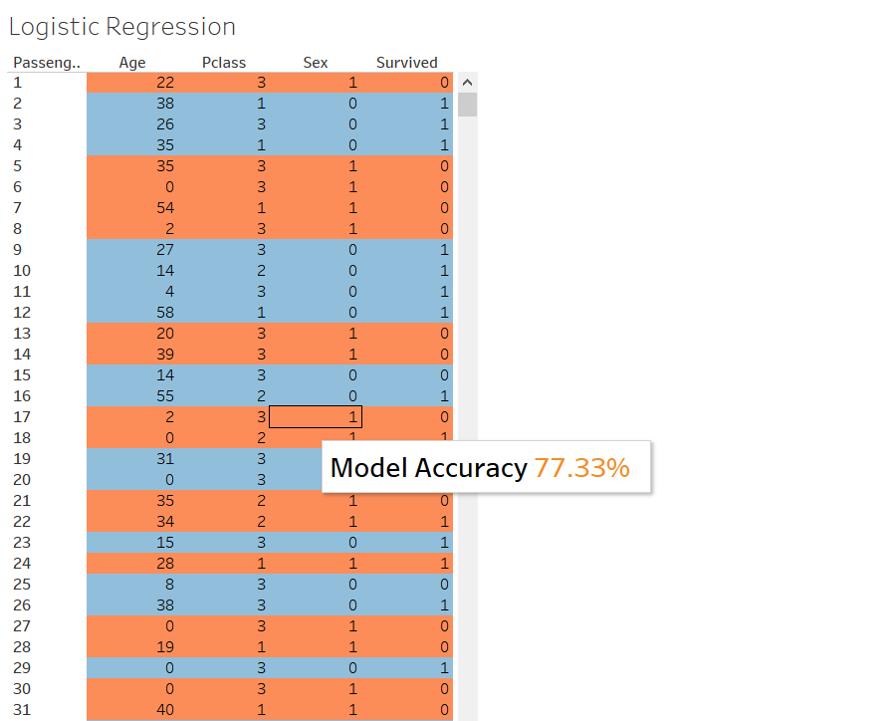
Logistic Regression
Notes:
Mo
a b c d variables, effect of b, c, d on a.
tableau 2 dimensions. multi - python

Slide 49
Key Takeaways
Regression
Helps to PROJECT future values
Finds RELATIONSHIPS in data
Different models for different DATA TYPES
Good START to more complex analysis
Notes:
Mo
Different models different data types, binary/ numerical
Simple Regression models are just the beginning of a complex analysis
more predictive capabilities are of course possible, whether estimating binary results or more continuous values

Slide 50
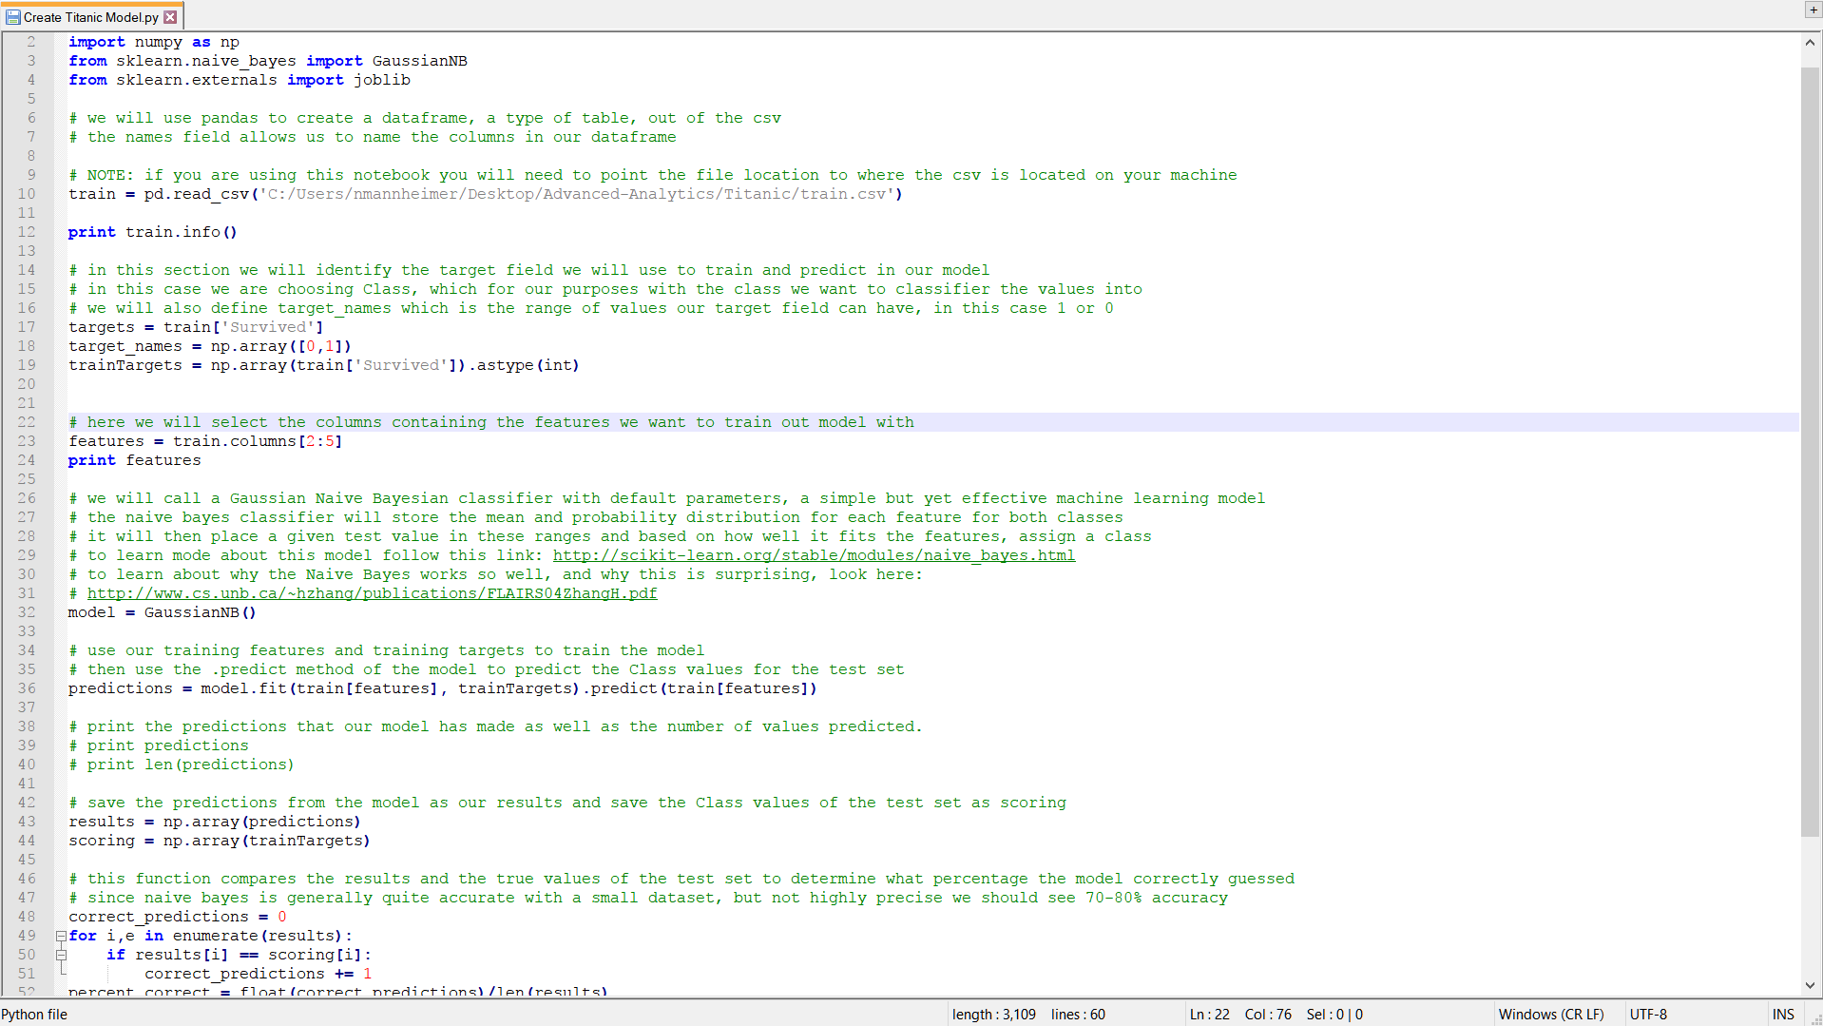

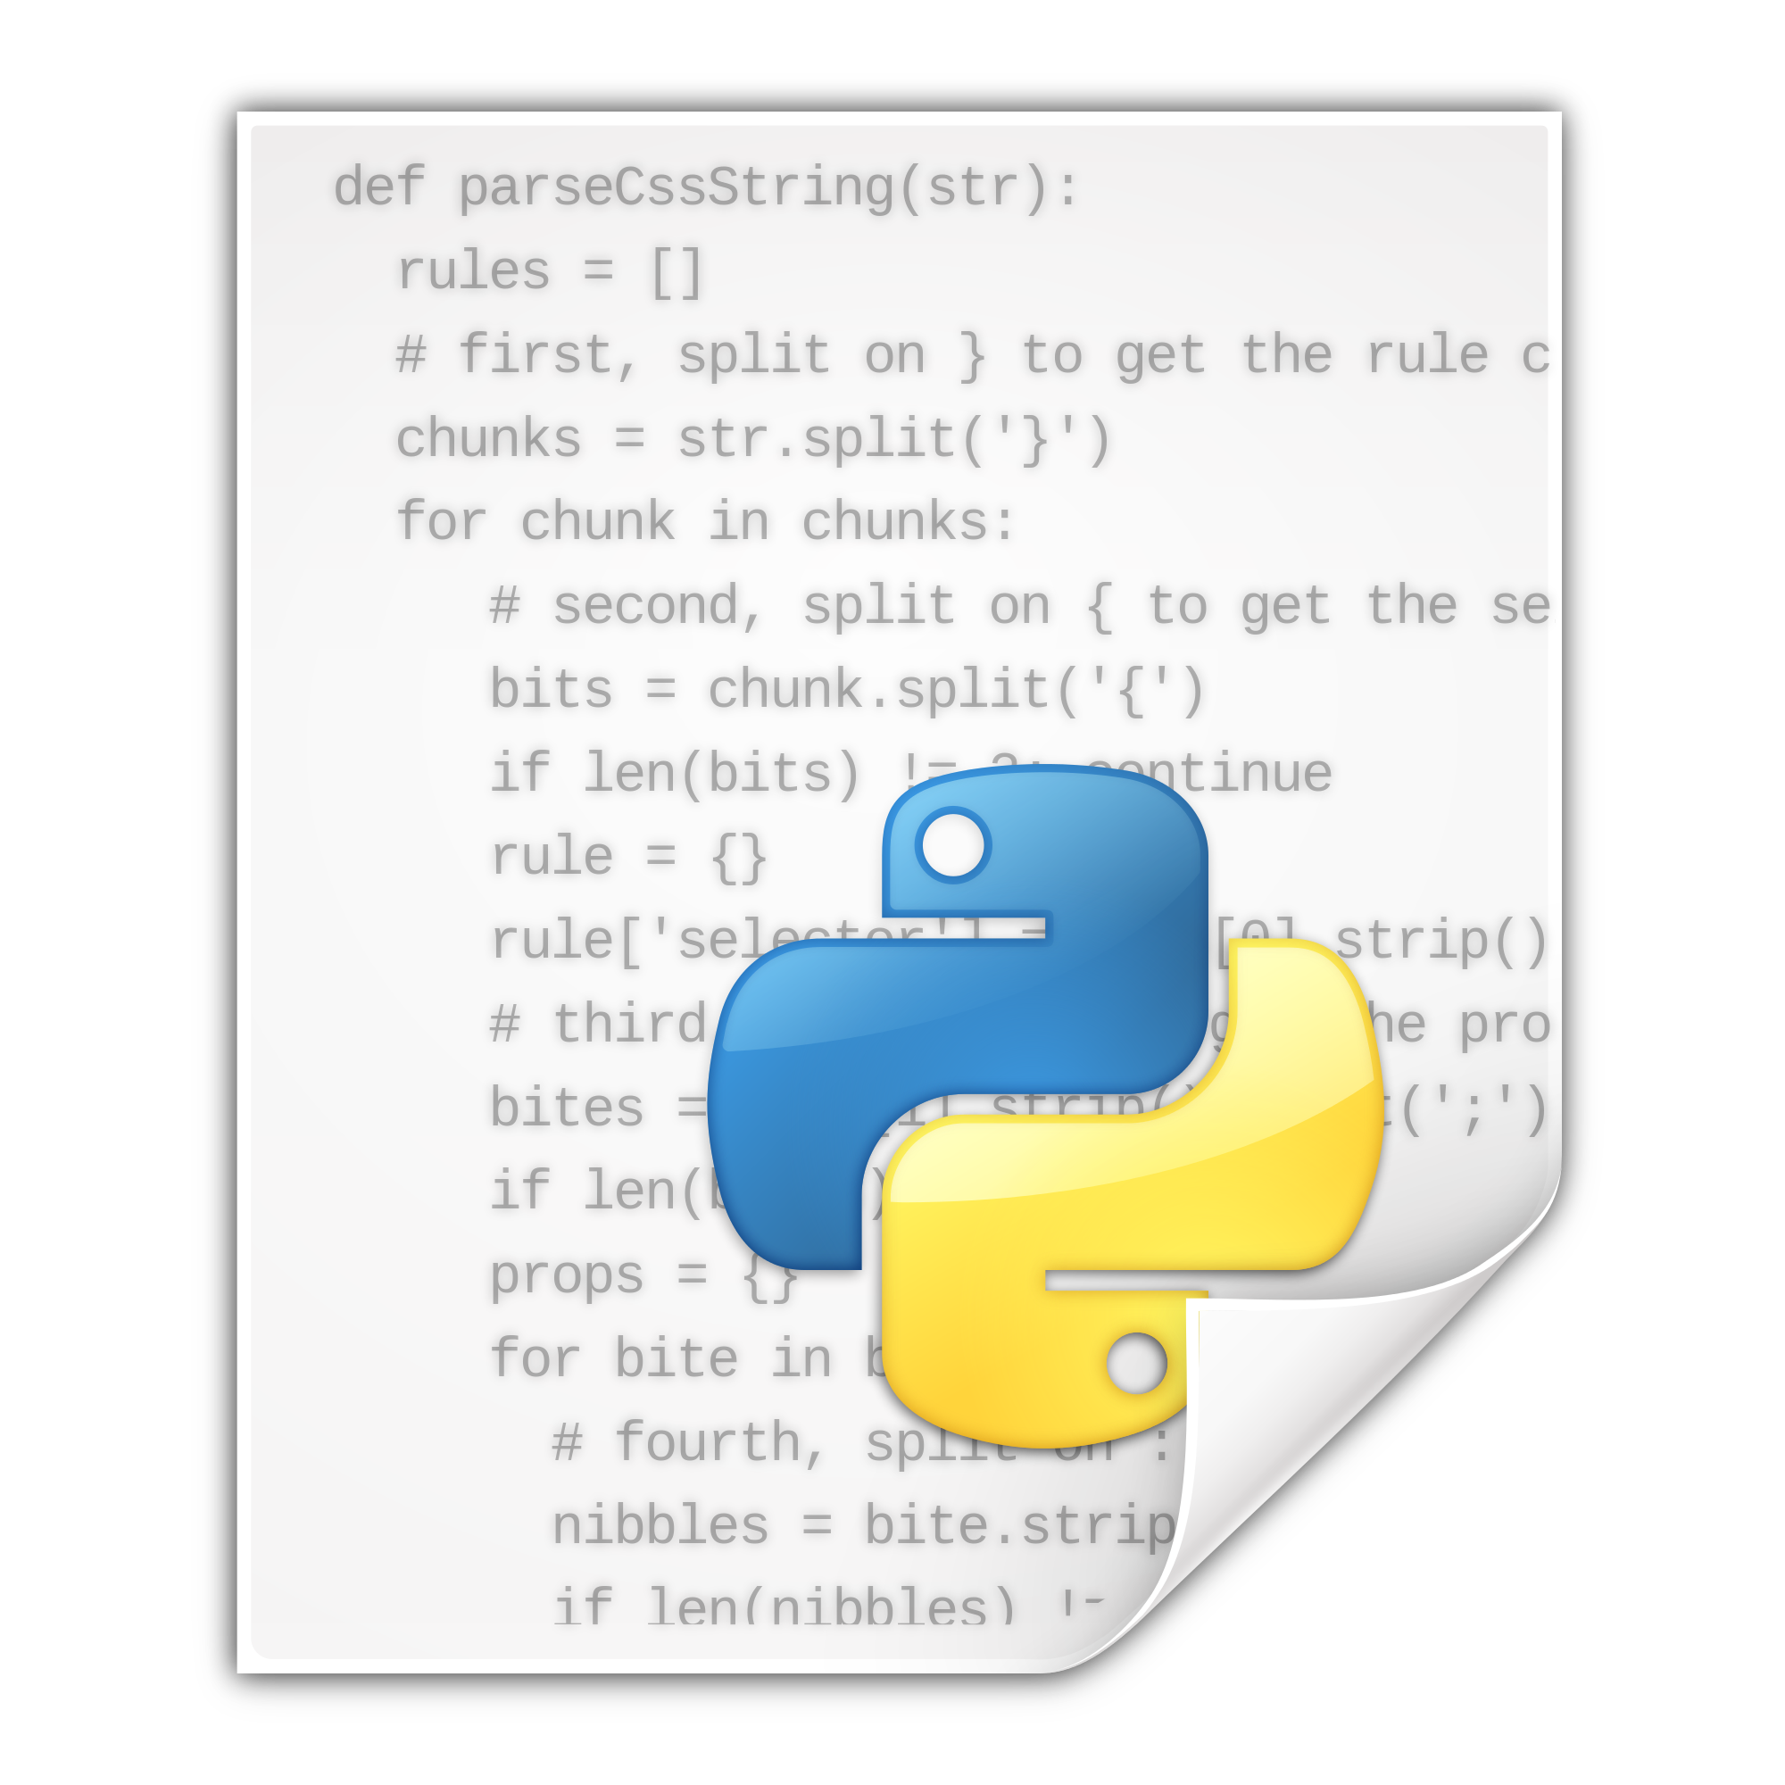

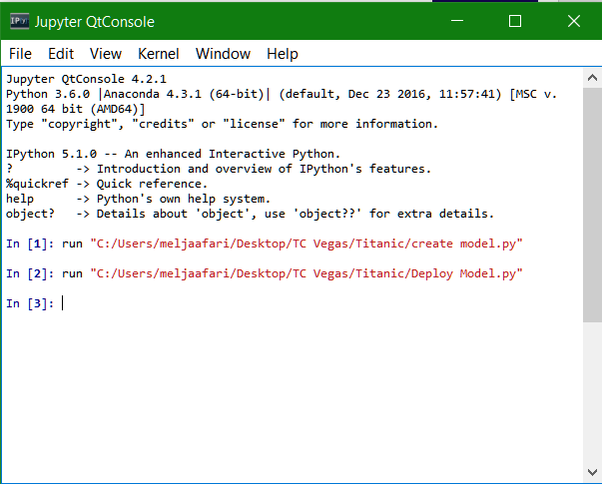
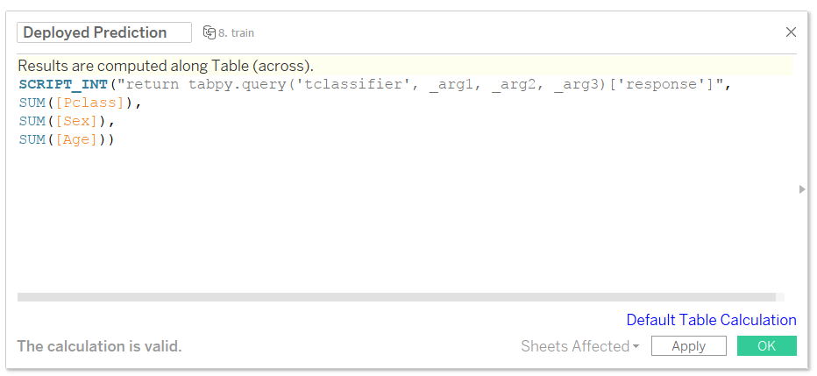
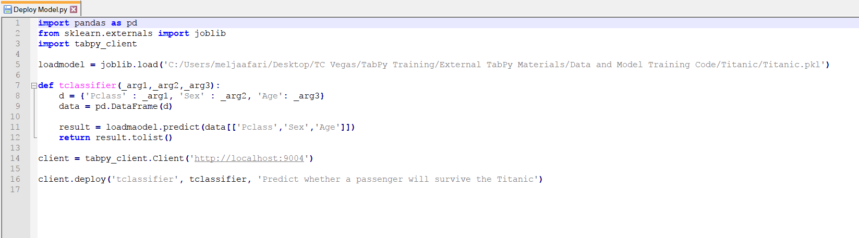



Deploying a Model
Notes:
If you have a team of data scientists developing custom models in your company, TabPy can also facilitate sharing those models with others who want to leverage them inside Tableau via published model.
Once published, all it takes to run a machine-learning model is a single line of Python code in Tableau regardless of model type or complexity.
Using published models has several benefits. Complex functions become easier to maintain, share, and reuse as deployed methods in the predictive-service environment. You can improve and update the model and code behind the endpoint while the calculated field keeps working without any change. And a dashboard author does not need to know or worry about the complexities of the model behind this endpoint

Slide 51
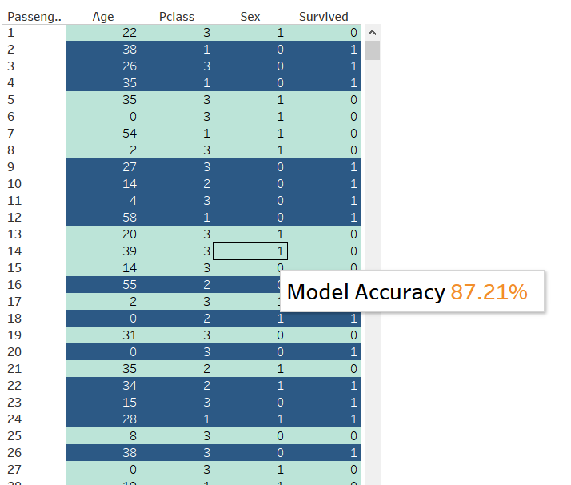
Deployed Model (Gaussian Naive Bayes)

Slide 52
Tableau Server
Notes:
Rachel

Slide 53
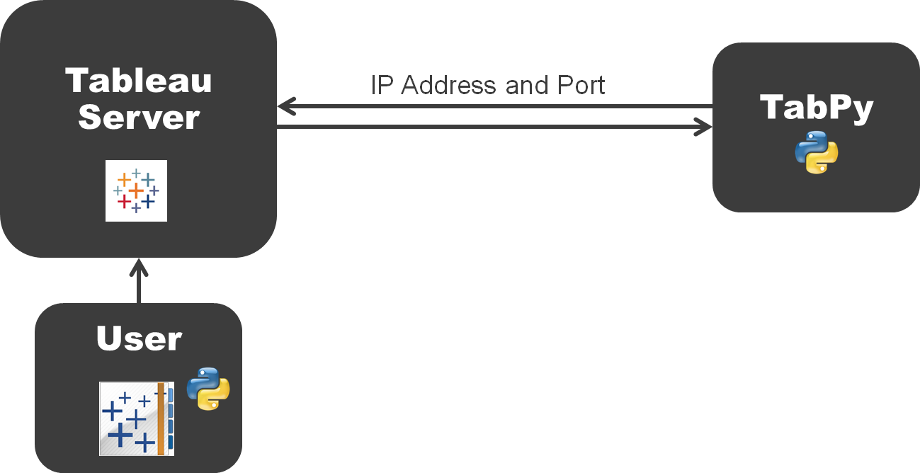
TabPy and Tableau Server
Notes:
Rachel
Use tabadmin commands to set up Tableau Server connection to TabPy instance
Tabadmin set vizqlserver.extsvc.host <ip address of Rserve or TabPy Server>
Tabadmin set vizqlserver.extsvc.port <port of Rserve or TabPy Server>
https://github.com/tableau/TabPy

Slide 54
Set Connection with Tabadmin
Set the IP
Tabadmin set vizqlserver.extsvc.host <ip address of TabPy Server>
Set the Port
Tabadmin set vizqlserver.extsvc.port <port of TabPy Server>
Notes:
Rachel

Slide 55
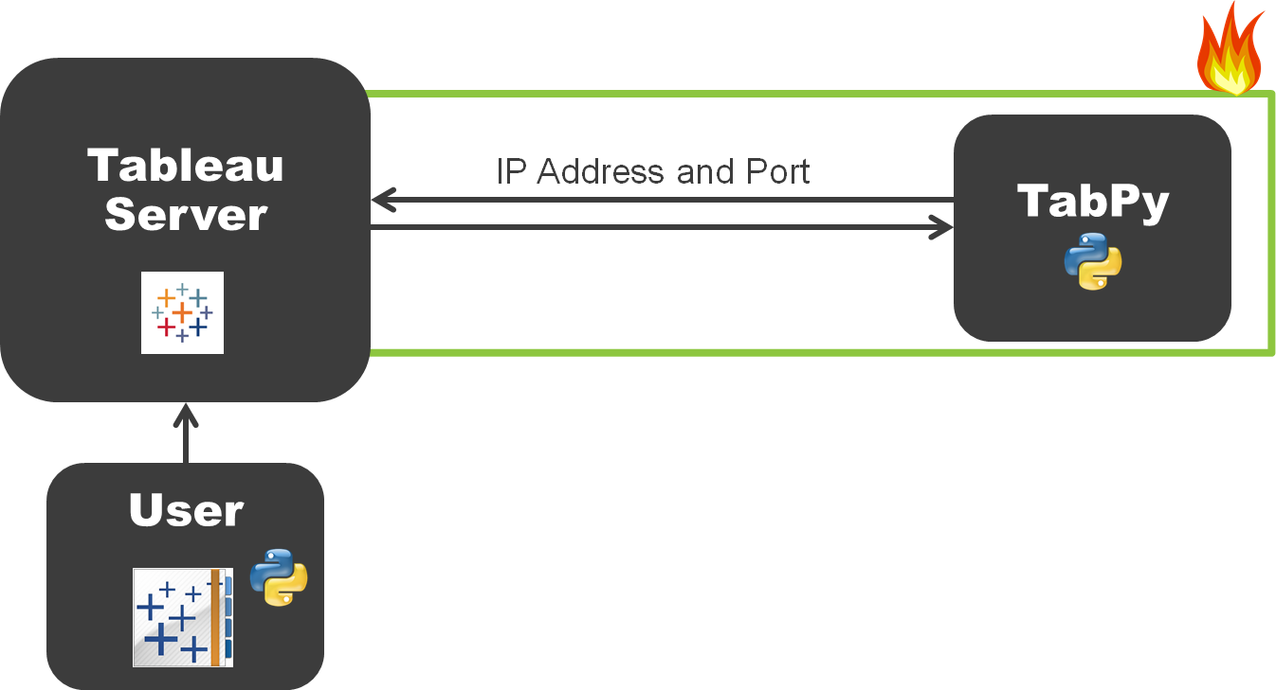
Stay Secure!
Notes:
Mo
Security Considerations
The following security issues should be kept in mind as you use TabPy with Tableau:
The data channel between Tableau and TabPy is currently not encrypted.
TabPy currently does not use authentication.

Slide 56
External Services and Tableau Server
Put External Services on separate computer to Tableau Server
2. Limit permissions TabPy
3. Open communication to only Tableau Server Machine
Please talk to your security team about these issues before enabling External Services Integration on your Tableau Server
Notes:
Mo
Python scripts can contain code which can harm security on the server where the TabPy is running. For example:
Access file system (read/write)
Install new Python packages which can contain binary code
Execute operating system commands
Open network connections to other servers and download files

Slide 57
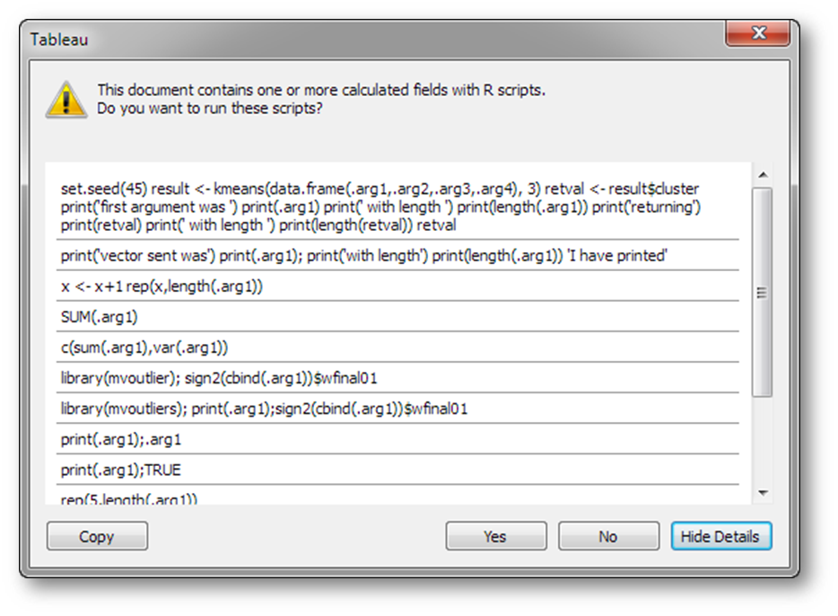
Security on Desktop
Notes:
Mo

Slide 58
TabPy Takeaways
Notes:
Rachel & Mo
enables powerful scenarios - explore the results in many ways in Tableau
leveraging the power of a large number of machine-learning libraries

Slide 59
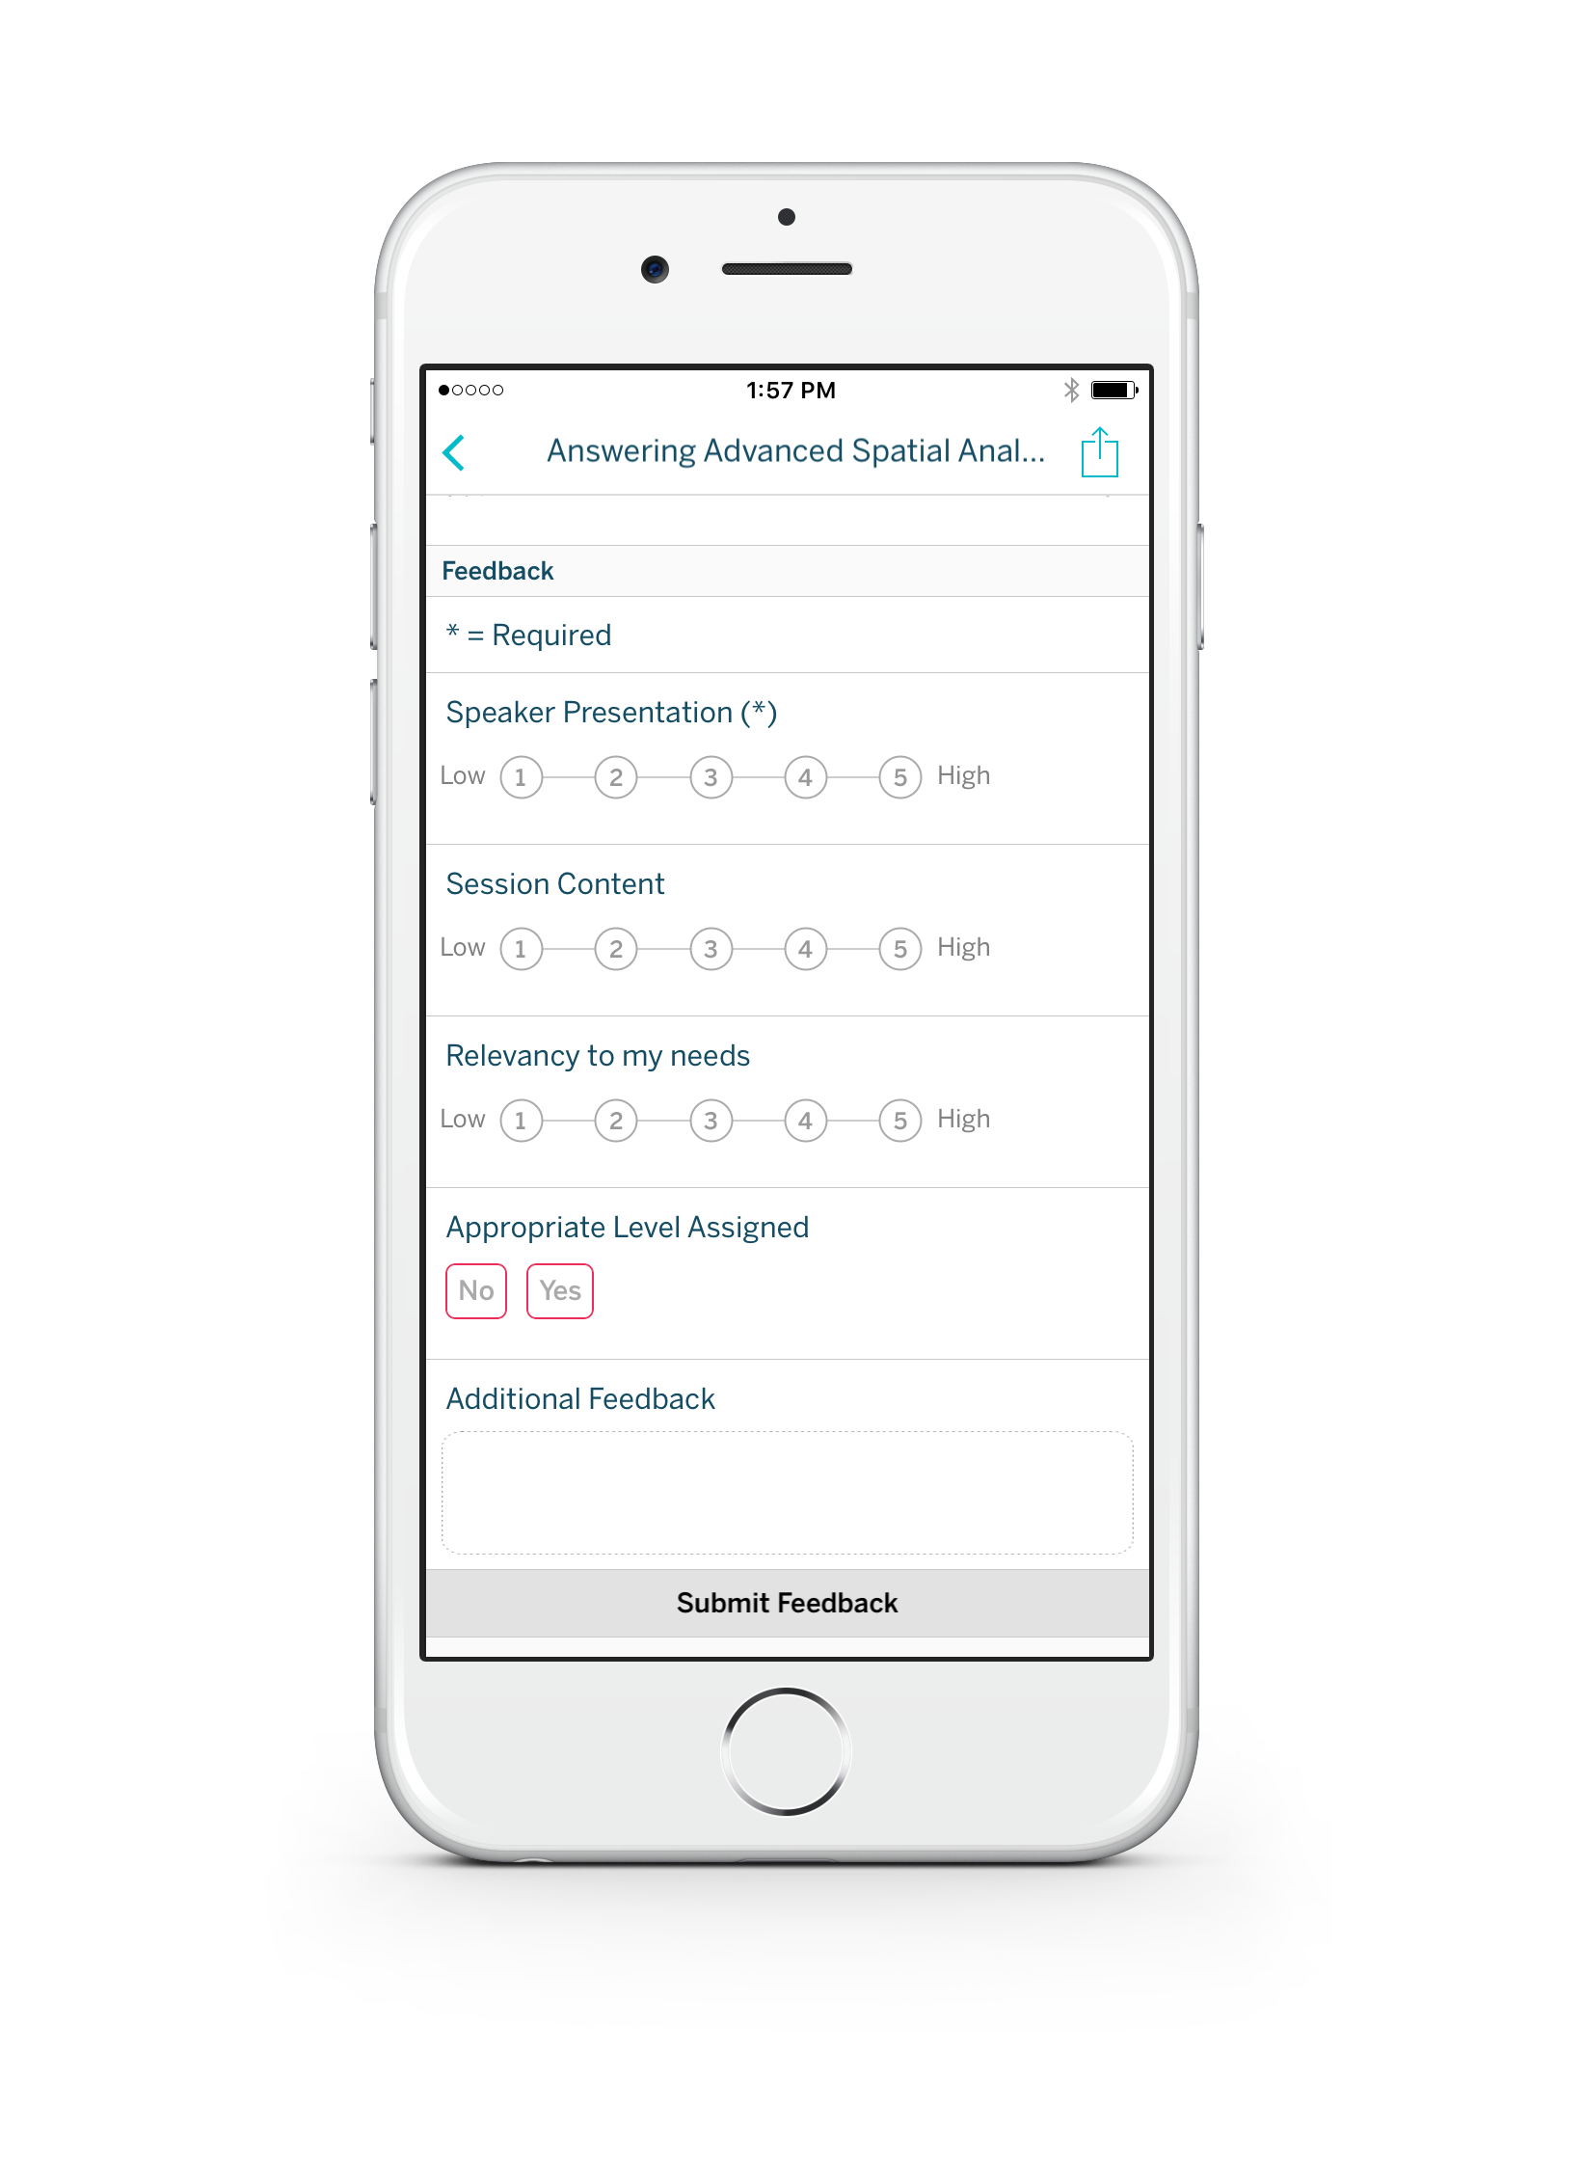
Please complete the session survey from the Session Details screen in your TC17 app

Slide 60
SESSION REPEATS
Wednesday, Oct 11
10:15 AM - 12:45 PM | South - L3 - South Seas I
1:30 PM - 4:00 PM | South - L2 - Lagoon H
Thursday, Oct 12
10:30 AM - 1:00 PM | North - Islander C

Slide 61
RELATED SESSIONS
Wednesday, October 11 Get on it, stat: Statistical analysis skills in Tableau
10:15am – 12:45pm | South - L2 - Mandalay Bay J
Wednesday, October 11 Achieving goals via analytics
1:30pm – 2:30pm | South - L2 - Oceanside C
Thursday, October 12 The forecast looks bright: Tableau forecasting
11:30am – 12:30pm | North - South Pacific E

Slide 62

Thanks for Listening
Notes:
Thanks for listening Jedis

